Slide 1

Go, change the world
RV College of
Engineering
Department of Master of Computer Applications
20MCA 36 - Minor Project – Phase II Review
e-Resources Website for Rvce Using SOA
Under the Guidance
Dr.Divya T L
Assistant Professor
RV College of Engineering, Bangalore,560059
Mohan Pujari (1RV20MC052)
Ashish Bisht (1RV20MC012)

Slide 2
Agenda
Incorporation of Suggestions of previous review
Objectives
Functional Requirements ( Modules description)
Non-functional Requirements ( Relevant to the project )
Architectural Design
Modules identified
System Design
Implementation

Slide 3
Objectives
Collecting the Resources from main library
Creation of web application using SOA Pattern
Performing CRUD operation on the resources through the web application.

Slide 4
Functional Requirements
Module Specification
  Frontend Module
    Input - Interface for downloading resources
    Process - Fetching the file from Database to the download module
    Output - Displaying the downloaded file to the Student.

Slide 5
Functional Requirements
Module Specification
  Backend Module
    Input – Admin providing resources .
    Process – Uploading the resources on the database.
    Output - Displaying the resources on the user interface.

Slide 6
Non Functional Requirements
Availability :
Resources will be 24/7 available on the website
Security :
Only valid user will be having access to login and access the resources.
Maintainability:
Its easy to maintain the resources.

Slide 7
Non Functional Requirements
Safety :
Students authentication will not be shared to others.

Slide 8
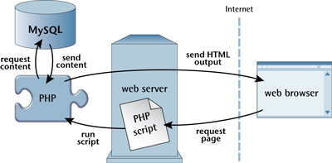
Architectural Design

Slide 9
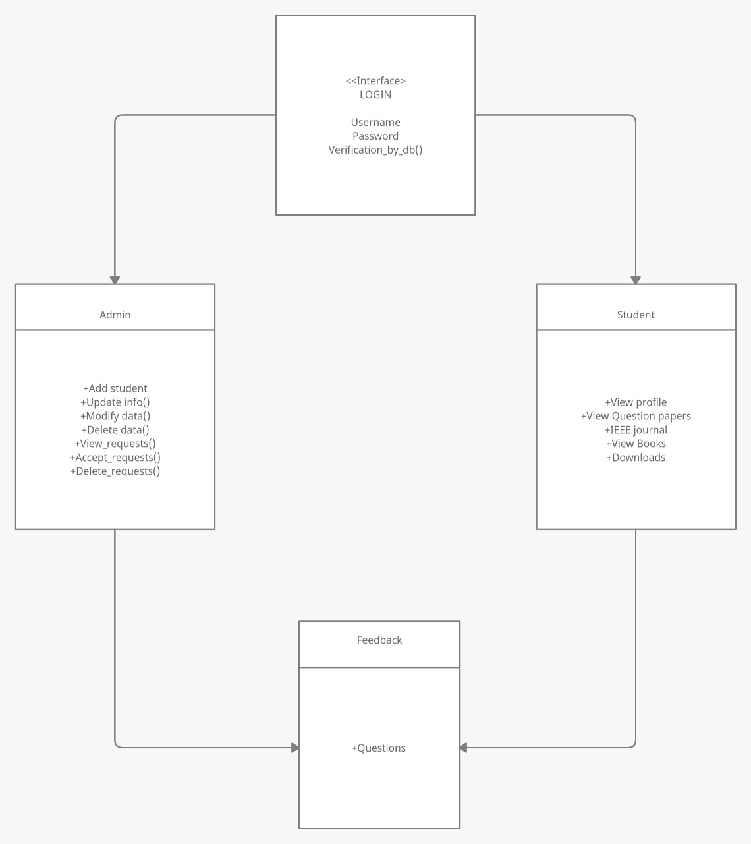
System Design
    UML diagram

Slide 10
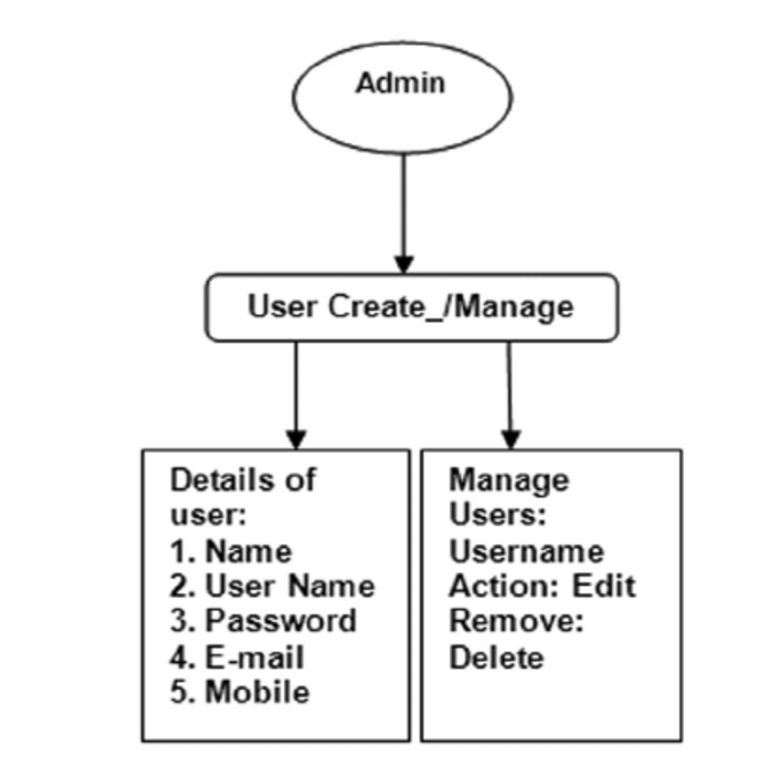
Functional Modeling
Data flow diagram

Slide 11
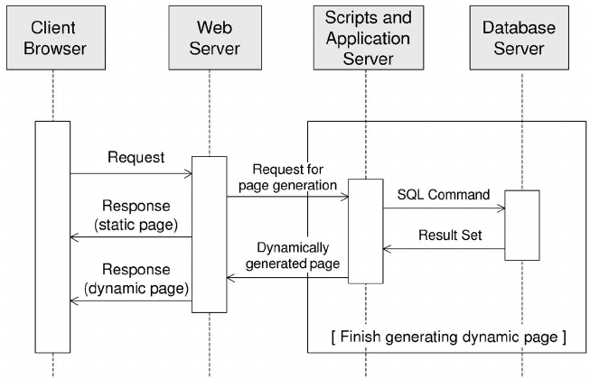
System Design
Sequence diagram

Slide 12
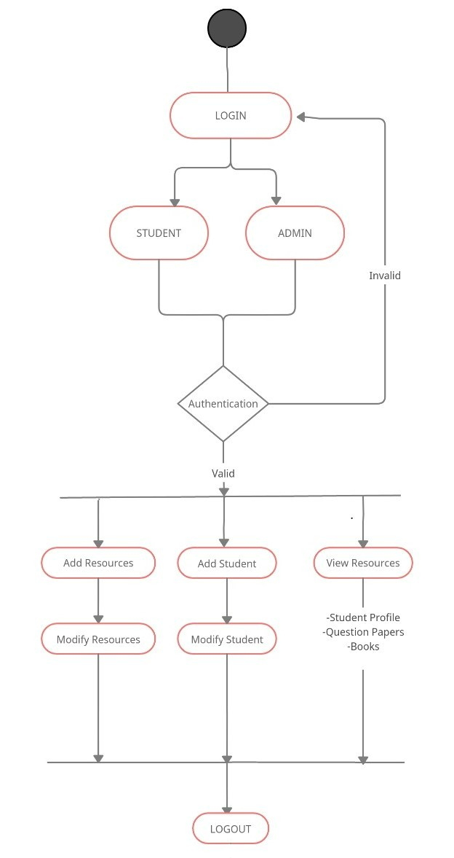
Activity diagram

Slide 13
Implementation
Resources has been collected.
A Graphical User Interface has been created for user.
Database has been connected to user interface.

Slide 14
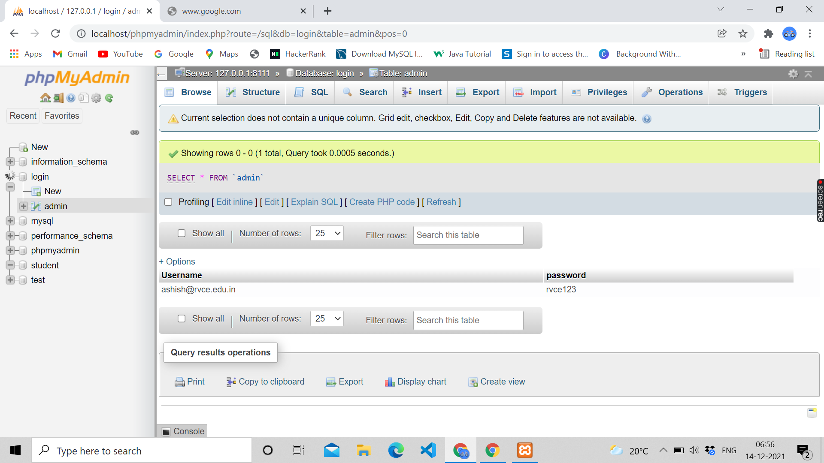
Implementation

Slide 15
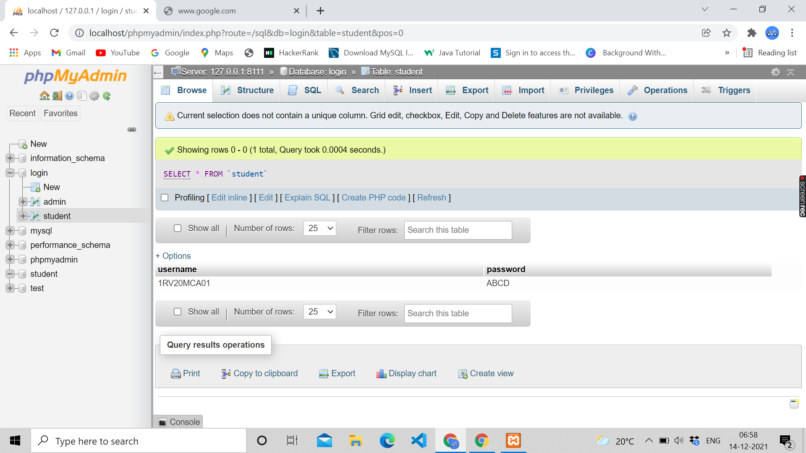
Implementation

Slide 16
References
Kumari, Punam, and Rainu Nandal. "A Research Paper On Website Development Optimization Using Xampp/PHP." International Journal of Advanced Research in Computer Science (2017), Vol 8.5 pp1231-1235.
Pirnau, C. and Botezatu, M.A., 2016. Service-Oriented Architecture (SOA) and Web Services. Database Systems Journal BOARD, p.32.
López-Gorozabel O, Cedeño-Palma E, Pinargote-Ortega J, Zambrano-Romero W, Pazmiño-Campuzano M. Bootstrap as a Tool for Web Development and Graphic Optimization on Mobile Devices. InXV Multidisciplinary International Congress on Science and Technology 2020 Oct 19 :pp. 290-302.
Dragoni N, Giallorenzo S, Lafuente AL, Mazzara M, Montesi F, Mustafin R, Safina L. Microservices: yesterday, today, and tomorrow. Present and ulterior software engineering. 2017: pp:195-216

Slide 17
References
5. Feljan, Aneta Vulgarakis, Swarup Kumar Mohalik, Mahesh Babu Jayaraman, and Ramamurthy Badrinath. "SOA-PE: a service-oriented architecture for planning and execution in cyber-physical systems." In 2015 International Conference on Smart Sensors and Systems (IC-SSS), IEEE, 2015, pp. 1-6.
6. Macaulay, Michael. Introduction to web interaction design: With HTML and CSS. Chapman and Hall/CRC, 2017. eBook ISBN 9781315692333.
7. Satoto, K.I., Isnanto, R.R., Kridalukmana, R. and Martono, K.T., 2016, October. Optimizing MySQL database system on information systems research, publications and community service. In 2016 3rd International Conference on Information Technology, Computer, and Electrical Engineering (ICITACEE) (pp. 1-5).

Slide 18
References
8 . Surjandari, I., Rachman, A., Panjaitan, Y. A. B., & Rosyidah, A. (2017, October). Development of theses categorization system search engine using PHP and MySQL. In 2017 International Conference on Information Technology Systems and Innovation (ICITSI),IEEE, (pp. 194-199).
9 . Pirnau, C. and Botezatu, M.A., 2016. Service-Oriented Architecture (SOA) and Web Services. Database Systems Journal BOARD, p.32.
10 . Korotun, Olha, Tetiana Vakaliuk, and Viacheslav Oleshko. "Development of a web- based system of automatic content retrieval database." Available at SSRN 3719834 (2020).
11 . Lopez, Daniel Andres Pelaez. "Requirement Analysis for Your Full-Stack Web Application." Full-Stack Web Development with Jakarta EE and Vue. js. Apress, Berkeley, CA, 2021. 111-142.

